Slide 2

“Why does sum of squares yield a different value of average deviation than absolute value?”

Slide 3

“Why does sum of squares yield a different value of average deviation than absolute value?”
?

Slide 4
What are we looking for?
Standard Deviation/Average Deviation = a value that summarizes the degree of variance
Values
2
6
4
8

Slide 5
What are we looking for?
Standard Deviation/Average Deviation = a value that summarizes the degree of variance
Values
2 + 4 + 6 + 8 = 20
2
3
6
Average
20/4 = 5
1
2
Distance
(Distribution)
3 + 1 + 3 + 1 = 8
4
1
Average Distance
8/4 = 2
8
3
5

Slide 6

However!
Absolute deviation does not uniquely characterize the dispersion of a distribution
2
3
6
1
2
4
1
8
Simply stupid explanation…
3
5

Slide 7
However!
Absolute deviation does not uniquely characterize the dispersion of a distribution
2
3
6
1
2
4
1
8
Simply stupid explanation…
3
5

Slide 8
ABSOLUTE DEVIATION
1
1 + 2 + 3 + 4 = 10
10 / 4 = 2.5
1 – 2.5 = - 1.5 = 1.5
2 – 2.5 = - 0.5 = 0.5
3 – 2.5 = 0.5 = 0.5
4 – 2.5 = 1.5 = 1.5
4
4 / 4 = 1
2
3
Mean 2.5
S.D. 1
4
3
0.5
0.5 + 2.5 + 2.5 + 4.5 = 10
10 / 4 = 2.5
0.5 – 2.5 = - 2 = 2
2.5 – 2.5 = 0 = 0
2.5 – 2.5 = 0 = 0
4.5 – 2.5 = 2 = 2
4
4 / 4 = 1
2.5
2.5
Mean 2.5
S.D. 1
4.5
4

Slide 9
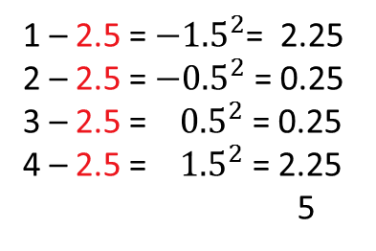
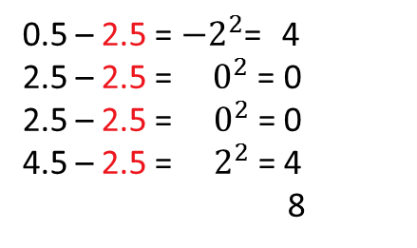
STANDARD DEVIATION
1
1 + 2 + 3 + 4 = 10
10 / 4 = 2.5
1 – 2.5 = ${−1.5}^{2}$= 2.25
2 – 2.5 = ${−0.5}^{2}$ = 0.25
3 – 2.5 = ${0.5}^{2}$ = 0.25
4 – 2.5 = ${1.5}^{2}$ = 2.25
5
5 / 4 = 1.25
2
3
Mean 2.5
S.D. 1.25
4
3
0.5
0.5 + 2.5 + 2.5 + 4.5 = 10
10 / 4 = 2.5
0.5 – 2.5 = ${−2}^{2}$= 4
2.5 – 2.5 = ${ 0}^{2}$ = 0
2.5 – 2.5 = ${ 0}^{2}$ = 0
4.5 – 2.5 = $2^{2}$ = 4
8
8 / 4 = 2
2.5
2.5
Mean 2.5
S.D. 2
4.5
4

Slide 11
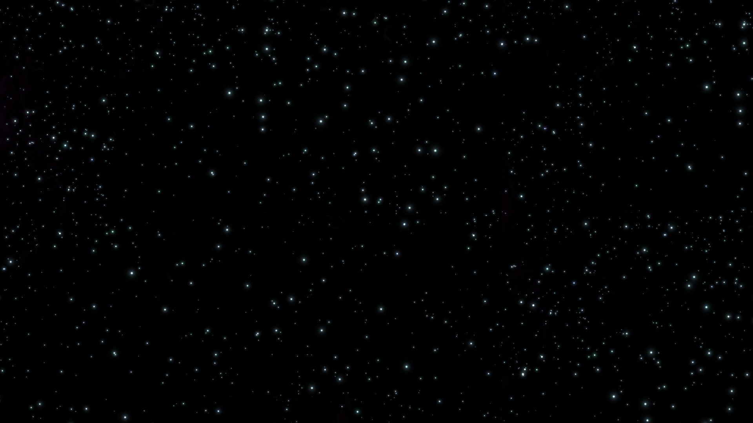

Slide 12
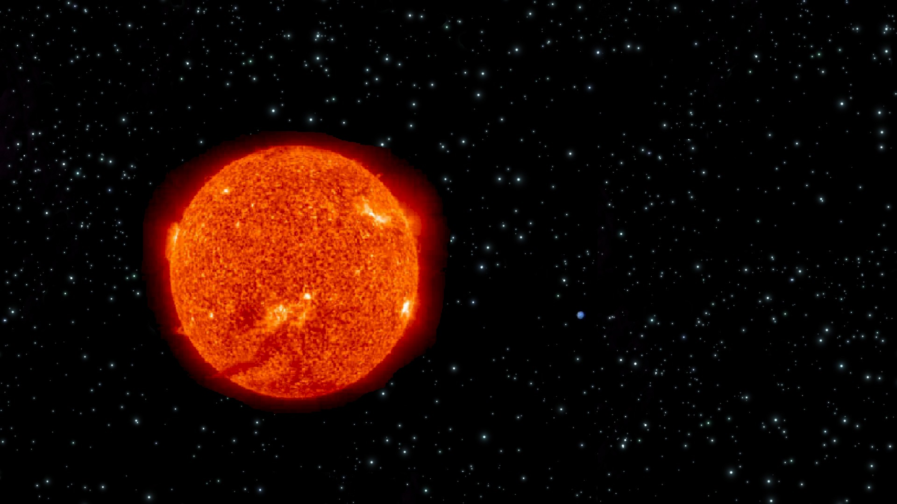
Earth

Slide 13
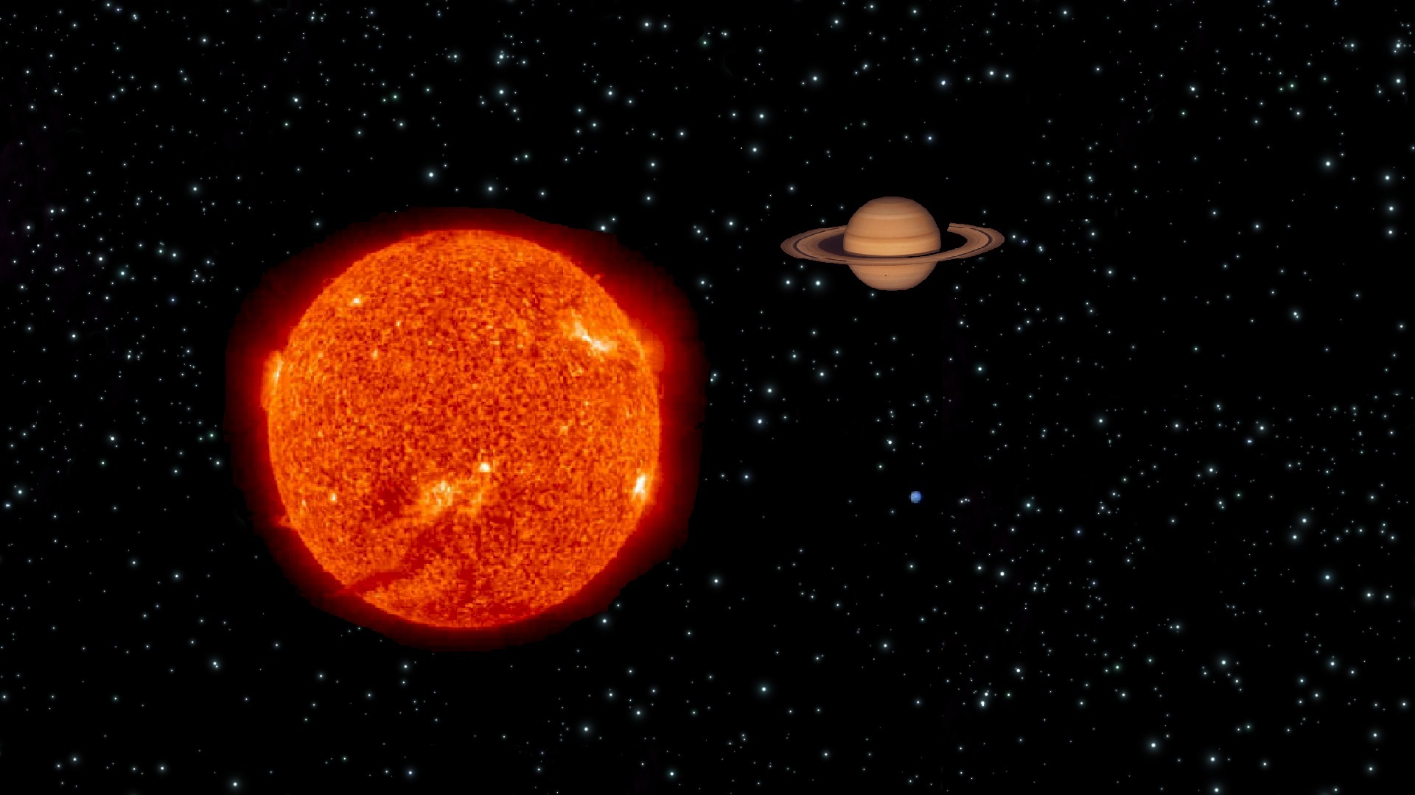
Earth

Slide 14
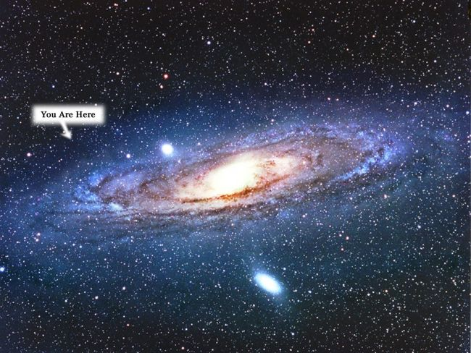
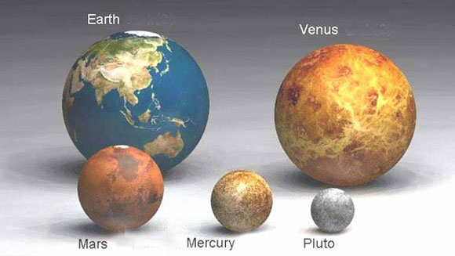
Earth

Slide 16
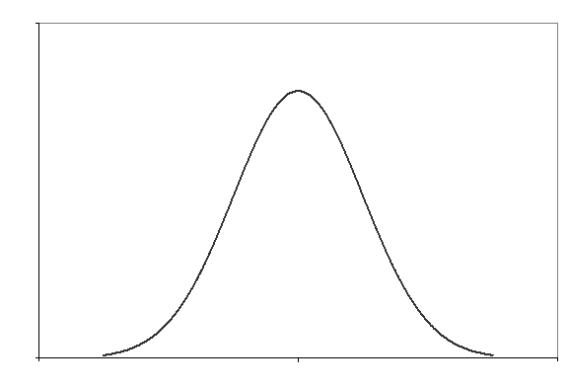

Slide 17
5’10”
5’7”
6’1”
5’4”
6’4”
5’1”
6’7”

Slide 18
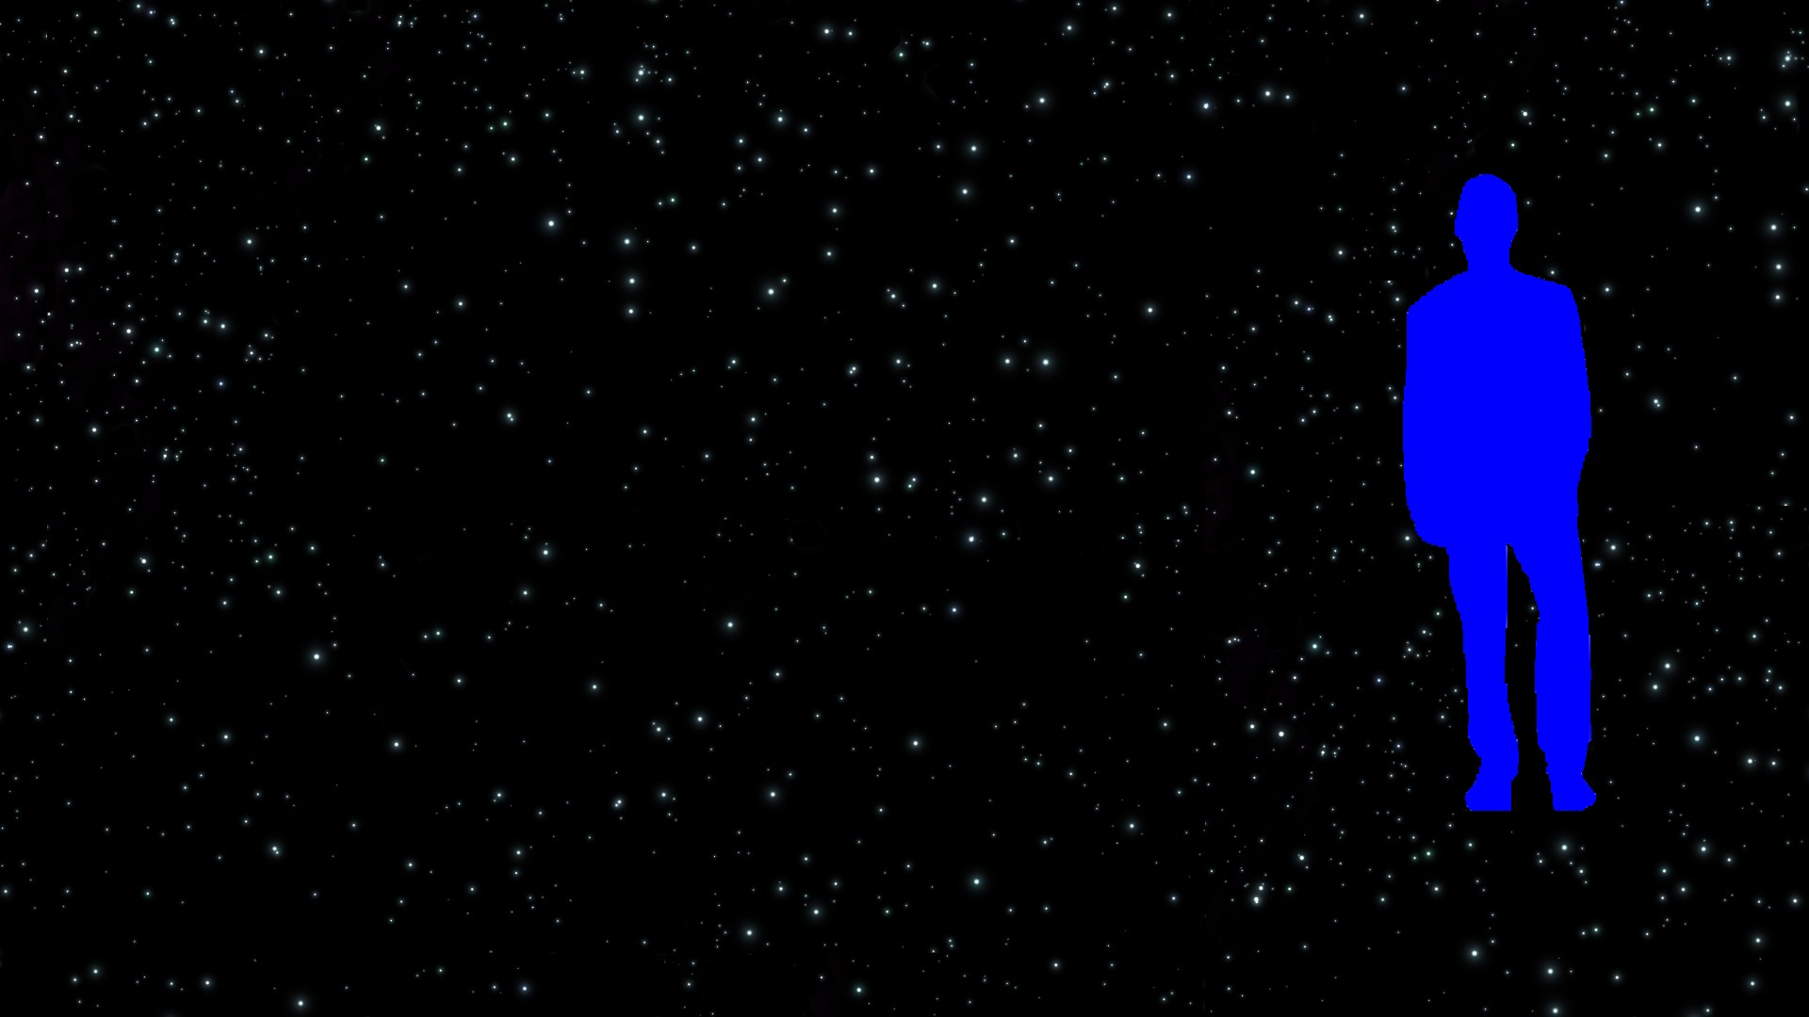

Simply stupid explanation…
Because our data dictates the mean.

Slide 20


